Slide 1

Linux Lecture-2
www.corvit.com

Slide 2
Topics
Interacting with Linux
Shells
File System
Directories
Commands
www.corvit.com

Slide 3
Interacting with Linux
GUI
Terminal (Command Line)
KDE
GNOME
XFCE
LXDE
MATE
Also called a shell
Just like Windows MS DOS Linux also have a command line through which it can be operated.
The Linux terminal is a text-based interface used to control a Linux computer. It's just one of the many tools provided to Linux users for accomplishing any given task, but it's widely considered the most efficient method available. Outside of writing code, it's certainly the most direct method possible.
www.corvit.com

Slide 4
Shell
The Shell is a Command Line Interpreter. It translates commands entered by the user and converts them into the language that is understood by the Kernel.
A Linux shell is an interactive program that accepts commands from user via key board, parse them from left to right and execute them. Most of the shells available in todays Linux provides the features of executing user commands and programs, I/O handling, programming ability (scripts and binaries). Example shells are Bourne shell, Bourne Again Shell, C Shell, Korn Shell.
Shell script is a list of commands which are listed in the order of execution.
www.corvit.com

Slide 5
Bourne Shell
1977
Created by Stephen Bourne.
Bourne shell is useful even today and in some cases as the default root shell.
Its grammar is similar to Algorithm Language (ALGOL)
The Bourne shell had two primary goals: command interpreter and scripting.
www.corvit.com

Slide 6
C Shell
1978
The C shell was developed by Bill Joy
Objective was to create a scripting language similar to C programming language.
This was useful given that C was a primary language in use back then which also made it easier and faster to use.
www.corvit.com

Slide 7
Korn Shell
1983
Developed by David Korn.
The Korn shell combined features of both Bourne and C shells.
It includes features from C shell such as job control, command aliasing and command history.
www.corvit.com

Slide 8
TENEX C Shell
1983
Started out as a derivative of the C shell but with a programmable command line completion and editing features added to it.
www.corvit.com

Slide 9
Bourne Again Shell (Bash)
1989
One of the most widely used shell today.
It was written be Brian Fox for the GNU project as a pre software replacement for the Bourne Shell.
Shows all features from the Bourne shell but is more efficient and easy to use.
It supports filename globing, piping, command substitution and control structures for conditional testing and iteration.
www.corvit.com

Slide 10
Other Shells
Many shells were evolved later such as Public Domain Korn Shell, Almquist Shell and Extensible Shell bringing in new features and dialects of their own suitable for different needs.
1990 zsh
1992 POSIX
1993 es
1994 scsh
1996 dash
1999 psh
2003 mksh
www.corvit.com

Slide 11
File System
At its base form a file system is just a way to organize your drive.
It determines the structure in which data is stored and retrieved.
Without this structure it would be very difficult to tell where one file ends and the other begins.
FAT 32, NTFS and Ext are some examples of File system.
www.corvit.com
Notes:
https://www.tecmint.com/linux-file-system-explained/

Slide 12
File System
FAT32: is a simple file system that is supported for reading and writes on all major operating systems. It has no security and does not perform well with large files.
NTFS: makes improvements on FAT with security and in many cases contiguous reads, but it still suffers some similar aliments.
Ext: is generally a good choice for working with most files, however small files would benefit more from contiguous allocation.
www.corvit.com

Slide 13
Contiguous and Noncontiguous Memory Allocation
Contiguous Memory Allocation : Contiguous memory allocation is basically a method in which a single contiguous section/part of memory is allocated to a process or file needing it. Because of this all the available memory space resides at the same place together, which means that the freely/unused available memory partitions are not distributed in a random fashion here and there across the whole memory space.
Non-Contiguous memory allocation: is basically a method on the contrary to contiguous allocation method, allocates the memory space present in different locations to the process as per it’s requirements. As all the available memory space is in a distributed pattern so the freely available memory space is also scattered here and there.
www.corvit.com
Notes:
The main memory is a combination of two main portions- one for the operating system and other for the user program. We can implement/achieve contiguous memory allocation by dividing the memory partitions into fixed size partitions.

Slide 14
Contiguous and Noncontiguous Memory Allocation
Contiguous
Noncontiguous
Overhead is minimum as not much address translations are there while executing a process.
Faster in Execution
It is easier for the OS to control.
Wastage of memory is there.
In contiguous memory allocation, swapped-in processes are arranged in the originally allocated space.
More Overheads are there as there are more address translations.
Slower in Execution
It is difficult for the OS to control.
No memory wastage is there
In non-contiguous memory allocation, swapped-in processes can be arranged in any place in the memory
www.corvit.com
Notes:
https://www.geeksforgeeks.org/difference-between-contiguous-and-noncontiguous-memory-allocation/

Slide 15
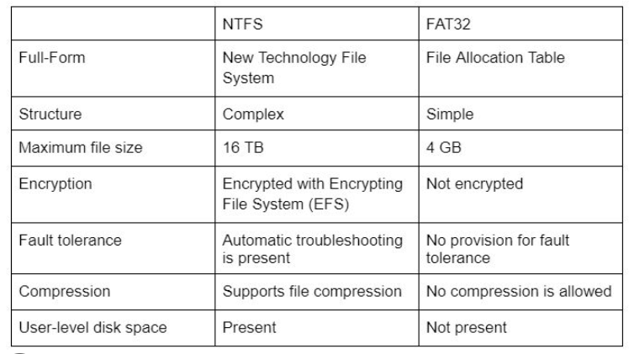
Brief Comparison
www.corvit.com

Slide 16
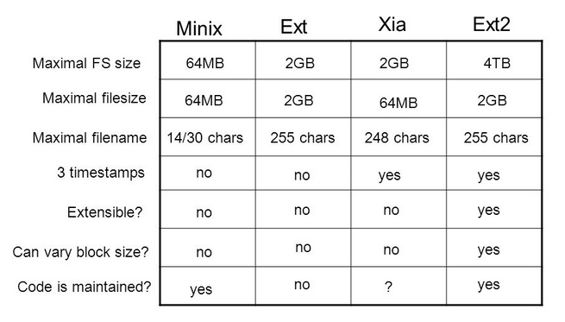
Brief Comparison
www.corvit.com

Slide 17
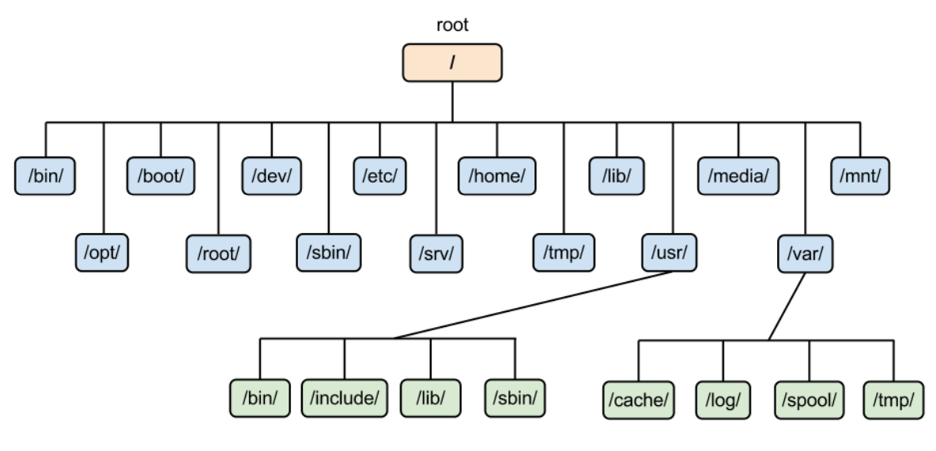
Linux File System
www.corvit.com

Slide 18
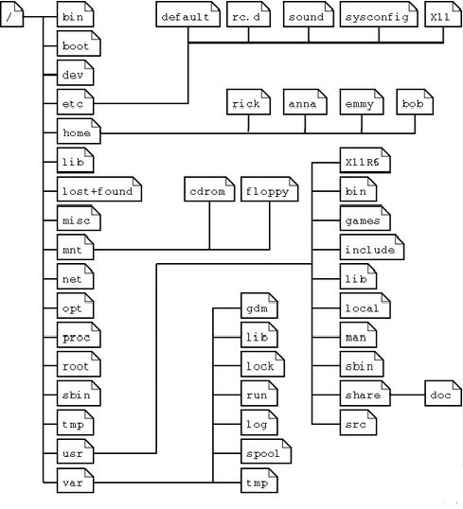
Linux File System
www.corvit.com

Slide 19
Linux Directory
The Linux file system is partitioned into separate directories, denoted by forward-slash character (/). – Tree structure starting with base (/) root directory.
Current directory you are in is called the current working directory.
Use the pwd command to print the current working directory and the ls command to list the contents of the directory.
www.corvit.com

Slide 20
Directories
These are the common top-level directories associated with the root directory:
/bin – binary or executable programs.
/etc – system configuration files.
/home – home directory. It is the default current directory.
/opt – optional or third-party software.
/tmp – temporary space, typically cleared on reboot.
/usr – User related programs.
/var – log files.
www.corvit.com
Notes:
https://www.geeksforgeeks.org/linux-directory-structure/

Slide 21
Directories
Some other directories in the Linux system:
/boot- It contains all the boot-related information files and folders such as conf, grub, etc.
/dev – It is the location of the device files such as dev/sda1, dev/sda2, etc.
/lib – It contains kernel modules and a shared library.
/lost+found – It is used to find recovered bits of corrupted files.
/media – It contains subdirectories where removal media devices inserted.
/mnt – It contains temporary mount directories for mounting the file system.
/proc – It is a virtual and pseudo-file system to contains info about the running processes with a specific process ID or PID.
/run – It stores volatile runtime data.
/sbin – binary executable programs for an administrator.
/srv – It contains server-specific and server-related files.
/sys – It is a virtual filesystem for modern Linux distributions to store and allows modification of the devices connected to the system.
www.corvit.com

Slide 22
Directories
Linux Kernel File:
/boot/vmlinux – The Linux kernel file.
Device Files:
/dev/hda – Device file for the first IDE HDD.
/dev/hdc – A pseudo-device that output garbage output is redirected to /dev/null.
www.corvit.com

Slide 23
Directories
System Configuration Files:
/etc/bashrc – It is used by bash shell that contains system defaults and aliases.
/etc/crontab – A shell script to run specified commands on a predefined time interval.
/etc/exports – It contains information on the file system available on the network.
/etc/fstab – Information of the Disk Drive and their mount point.
/etc/group – It is a text file to define Information of Security Group.
/etc/grub.conf – It is the grub bootloader configuration file.
/etc/init.d – Service startup Script.
/etc/lilo.conf – It contains lilo bootloader configuration file.
/etc/hosts – Information of IP and corresponding hostnames.
/etc/hosts.allow – It contains a list of hosts allowed accessing services on the local machine.
/etc/host.deny – List of hosts denied to access services on the local machine.
/etc/inittab – INIT process and their interaction at the various run level.
/etc/issue – Allows editing the pre-login message.
www.corvit.com

Slide 24
Directories
System Configuration Files:
/etc/modules.conf – It contains the configuration files for the system modules.
/etc/motd – It contains the message of the day.
/etc/mtab – Currently mounted blocks information.
/etc/passwd – It contains username, password of the system, users in a shadow file.
/etc/printcap – It contains printer Information.
/etc/profile – Bash shell defaults.
/etc/profile.d – It contains other scripts like application scripts, executed after login.
/etc/rc.d – It avoids script duplication.
/etc/rc.d/init.d – Run Level Initialisation Script.
/etc/resolv.conf – DNS being used by System.
/etc/security – It contains the name of terminals where root login is possible.
/etc/skel – Script that initiates new user home directory.
/etc/termcap – An ASCII file that defines the behavior of different types of the terminal.
/etc/X11 – Directory tree contains all the conf files for the X-window System.
www.corvit.com

Slide 25
Directories
User Related Files:
/usr/bin – It contains most of the executable files.
/usr/bin/X11 – Symbolic link of /usr/bin.
/usr/include – It contains standard include files used by C program.
/usr/share – It contains architecture independent shareable text files.
/usr/lib – It contains object files and libraries.
/usr/sbin – It contains commands for Super User, for System Administration.
www.corvit.com

Slide 26
Directories
Virtual and Pseudo Process Related Files:
/proc/cpuinfo – CPU Information
/proc/filesystems – It keeps the useful info about the processes that are running currently.
/proc/interrupts – it keeps the information about the number of interrupts per IRQ.
/proc/ioports – Contains all the Input and Output addresses used by devices on the server.
/proc/meminfo – It reports the memory usage information.
/proc/modules – Currently using kernel module.
/proc/mount – Mounted File-system Information.
/proc/stat – It displays the detailed statistics of the current system.
/proc/swaps – It contains swap file information.
www.corvit.com

Slide 27
Directories
Version Information File:
/version – It displays the Linux version information.
Log Files:
/var/log/lastlog – It stores user last login info.
/var/log/messages – It has all the global system messages.
/var/log/wtmp – It keeps a history of login and logout information.
www.corvit.com

Slide 28
Linux File Names
File names on Linux are case sensitive. – So are commands because these are just executable files!
Linux file names don’t have dot extensions like Windows.
A file name starting with a period (.) is called a hidden file and isn’t displayed in a standard directory listing.
www.corvit.com

Slide 29
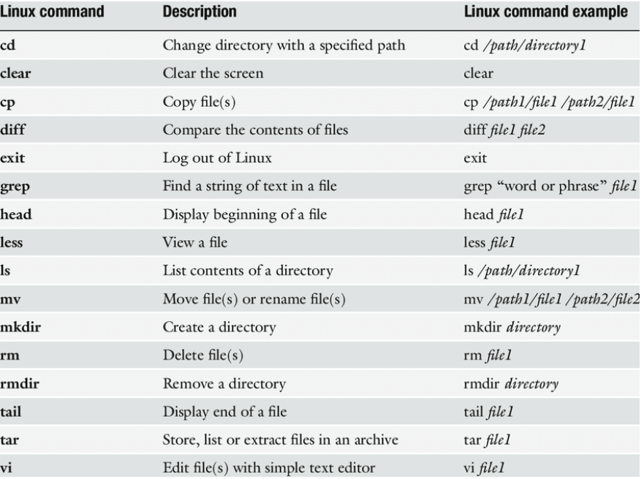
Linux Shell Commands
A shell command can be internal/built-in or External
The code to execute an internal command is part of the shell process, e.g., cd, dot, echo, pwd.
The code to process an external command resides in a file in the form of a binary executable program file or a shell script, e.g., cat, ls, mkdir, more.
The general syntax of a shell command is command [option(s)] [argument(s)]
After reading the command the shell determines whether the command is internal or external
It processes all internal commands by using the corresponding code segments that are within its own code
To execute an external command, it searches the command in the search path. Directories names stored in the PATH variable. [echo $PATH]
www.corvit.com
Notes:
https://www.hostinger.com/tutorials/linux-commands https://itsfoss.com/basic-terminal-tips-ubuntu

Slide 30
Changing Directory
The cd command is used to change the current working directory to a new one.
Two options:
Specify an absolute path name:
$ cd /home/bob/documents
Specify a relative path name:
$ cd documents change to documents sub-directory located in present directory
$ cd ../databases change to databases sub-directory located in parent directory
$ cd ~ change to user’s home directory
www.corvit.com

Slide 31
Managing Directory
Use the mkdir command to create a new directory.
– $ mkdir test
• Creates a sub-directory called test in the present directory.
– $ mkdir /home/bob/test
• Creates a sub-directory called test in the /home/bob directory.
Use the rmdir command to remove a directory.
– $ rmdir test
www.corvit.com

Slide 32
Creating Files
Easy way to create an empty text file is to use the touch command.
– $ touch myfile.txt
You can also use one of the basic text editors to create a file.
– $ nano myfile.txt (recommended for beginners)
– $ vi myfile.txt
www.corvit.com

Slide 33
Viewing Files
Linux provides a couple different tools to view the contents of text files.
– $ cat myfile.txt
– $ more myfile.txt (similar to cat but with pagination)
– $ less myfile.txt (less is more than more)
www.corvit.com

Slide 34
Listing Files
The ls command allows you to list the files in a directory. – $ ls – $ ls /home/ubuntu-user – $ ls ~
Add the –la option to the command to see more file details. – $ ls –la – $ ls –la /home/ubuntu-user
www.corvit.com

Slide 35
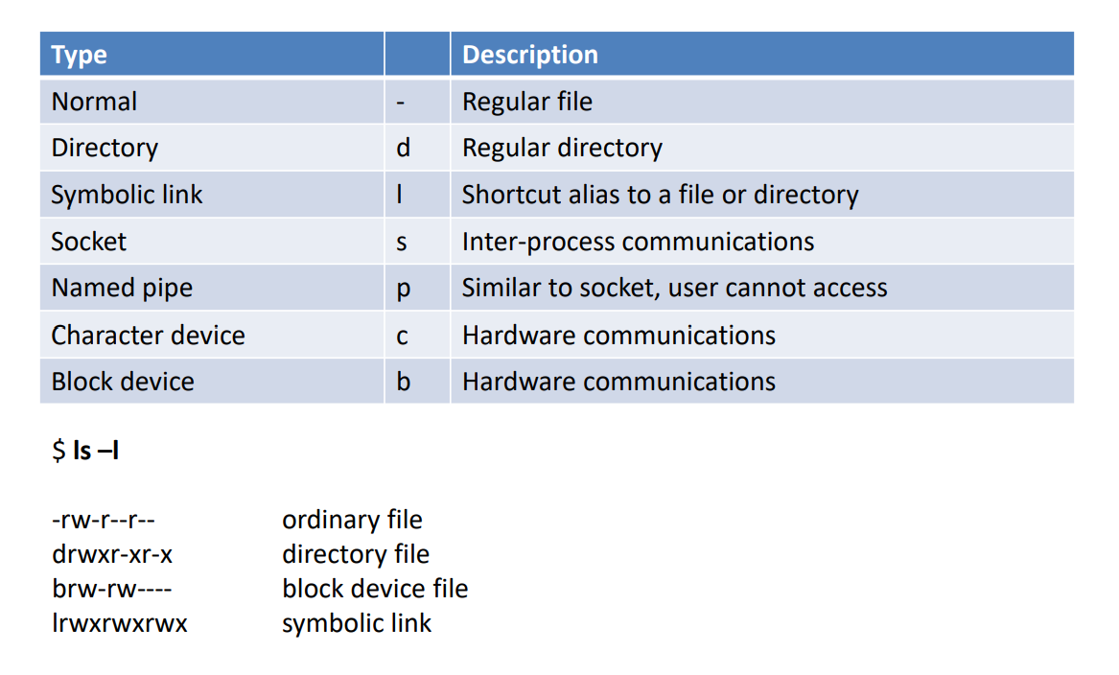
Linux File Types
www.corvit.com

Slide 36
Managing Files
Copy the file to another file location using the copy command. – $ cp myfile.txt myfile.bak
Move the file (rename) using the mv command. – $ mv myfile.txt myfile2.txt
Delete a file using the rm command. – $ rm myfile2.txt
www.corvit.com

Slide 37
Linux Command Help
Linux provides a couple different methods to get helpful information about a command: $ man <command> $ <command> --help
Sometimes the best way to get help is just using a web search engine.
www.corvit.com

Slide 38
Command Pipelines
A command pipe allows you to take the stdout (output) of a command and send it to the stdin (input) of another command.
A pipe is denoted using the vertical bar character (|).
– $ ls /var/www/html | sort
List the files /var/www/html directory and output the listing in alphabetical order
www.corvit.com

Slide 39
Shutdown and Restart
The shutdown command is used to shutdown a system (requires super-user privileges).
– $ sudo shutdown
To tell the system to automatically restart after shutting down:
– $ sudo shutdown –r now
www.corvit.com

Slide 40
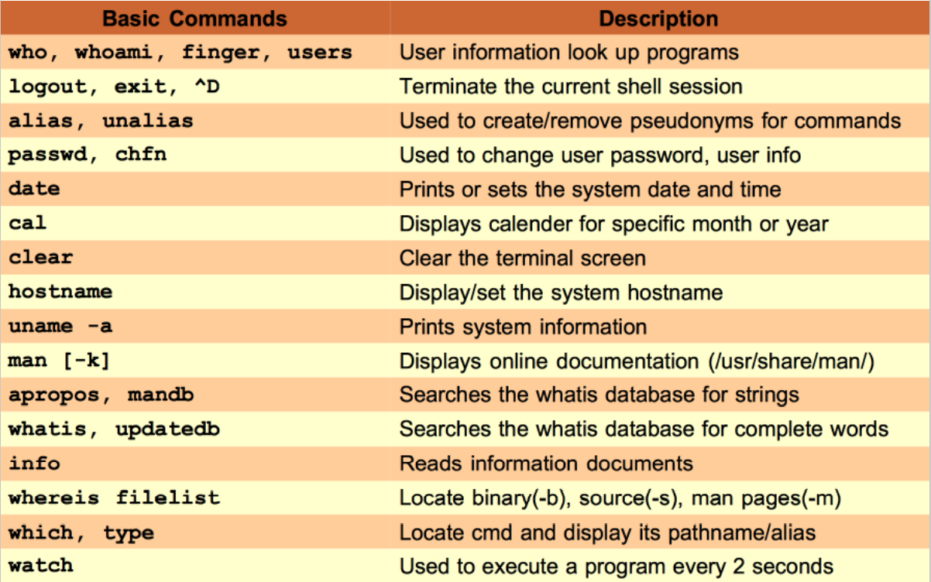
Basic Commands
www.corvit.com

Slide 41
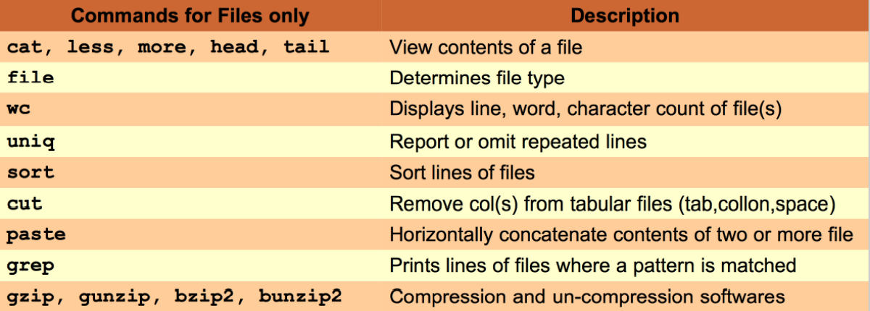
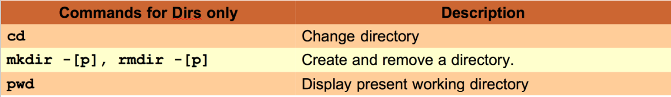
Files and Directories Commands
www.corvit.com

Slide 42
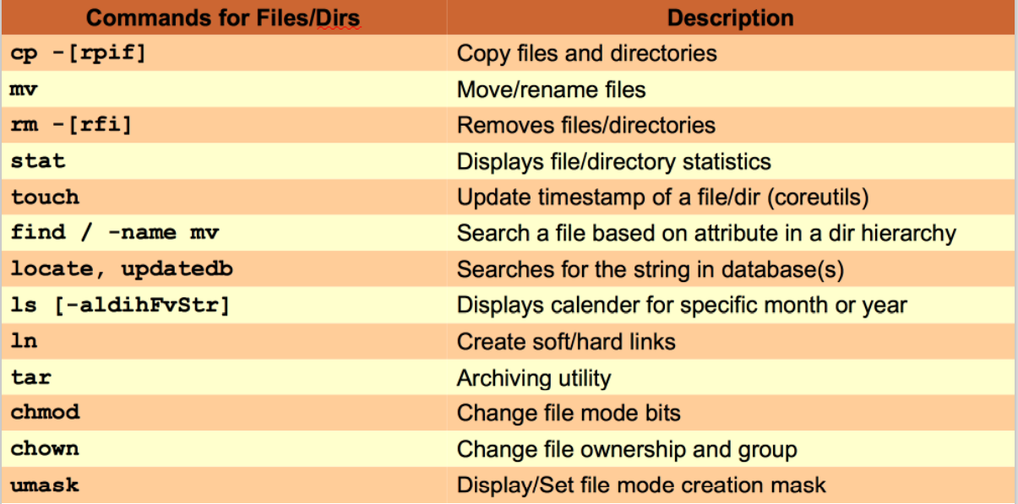
Files and Directories Commands
www.corvit.com

Slide 43
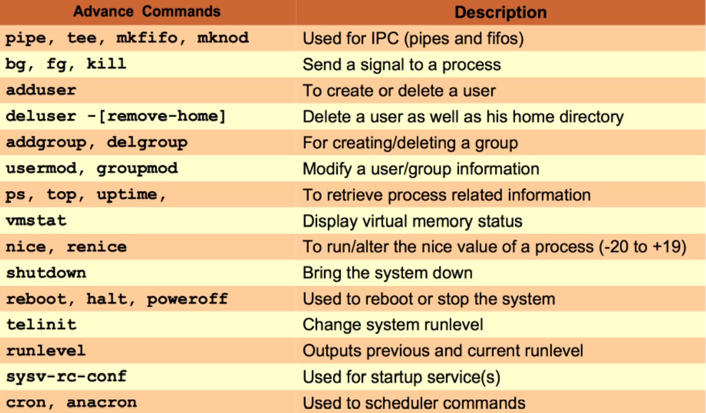
Advance Commands
www.corvit.com

Slide 44
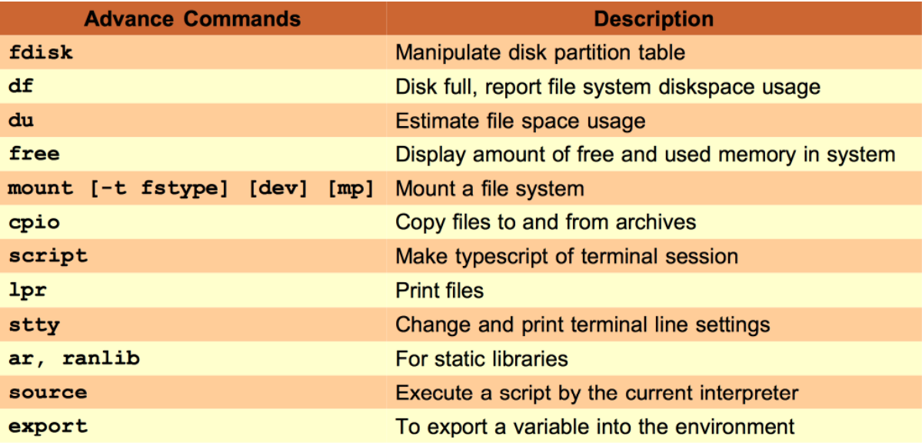
Advance Commands
www.corvit.com

Slide 45
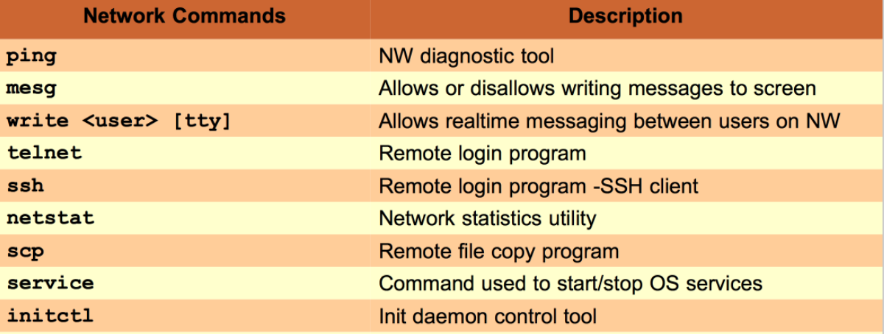
Network Commands
www.corvit.com

Slide 46
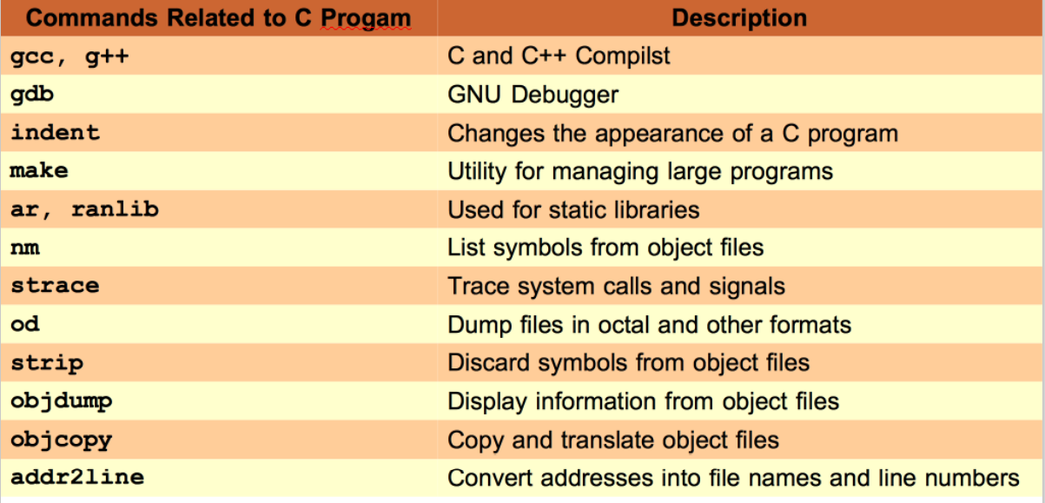
C Programming Commands
www.corvit.com

Slide 47
Linux Shell Shortcuts
The BASH shell provides a simple, yet powerful command entry interface. Useful shortcuts include:
– Ctrl+a: move the cursor to the beginning of the command line
– Ctrl+c: terminate a running program and return to the shell prompt
– Ctrl+d: log out of the current shell
– Ctrl+e: move cursor to the end of the command line
– Ctrl+l: clear the shell terminal screen
– Ctrl+r: search the command history
– <tab>: autocomplete file name
– <tab><tab>: show command completion possibilities
– <up-arrow>: repeat last command (or scroll through history)
www.corvit.com

